Slide 1

Mission Symposium
2012

Slide 2

From Mission to Text to Mission
Searching for Consistency in Interpreting and Applying Scripture
Mission Symposium 2012

Slide 3
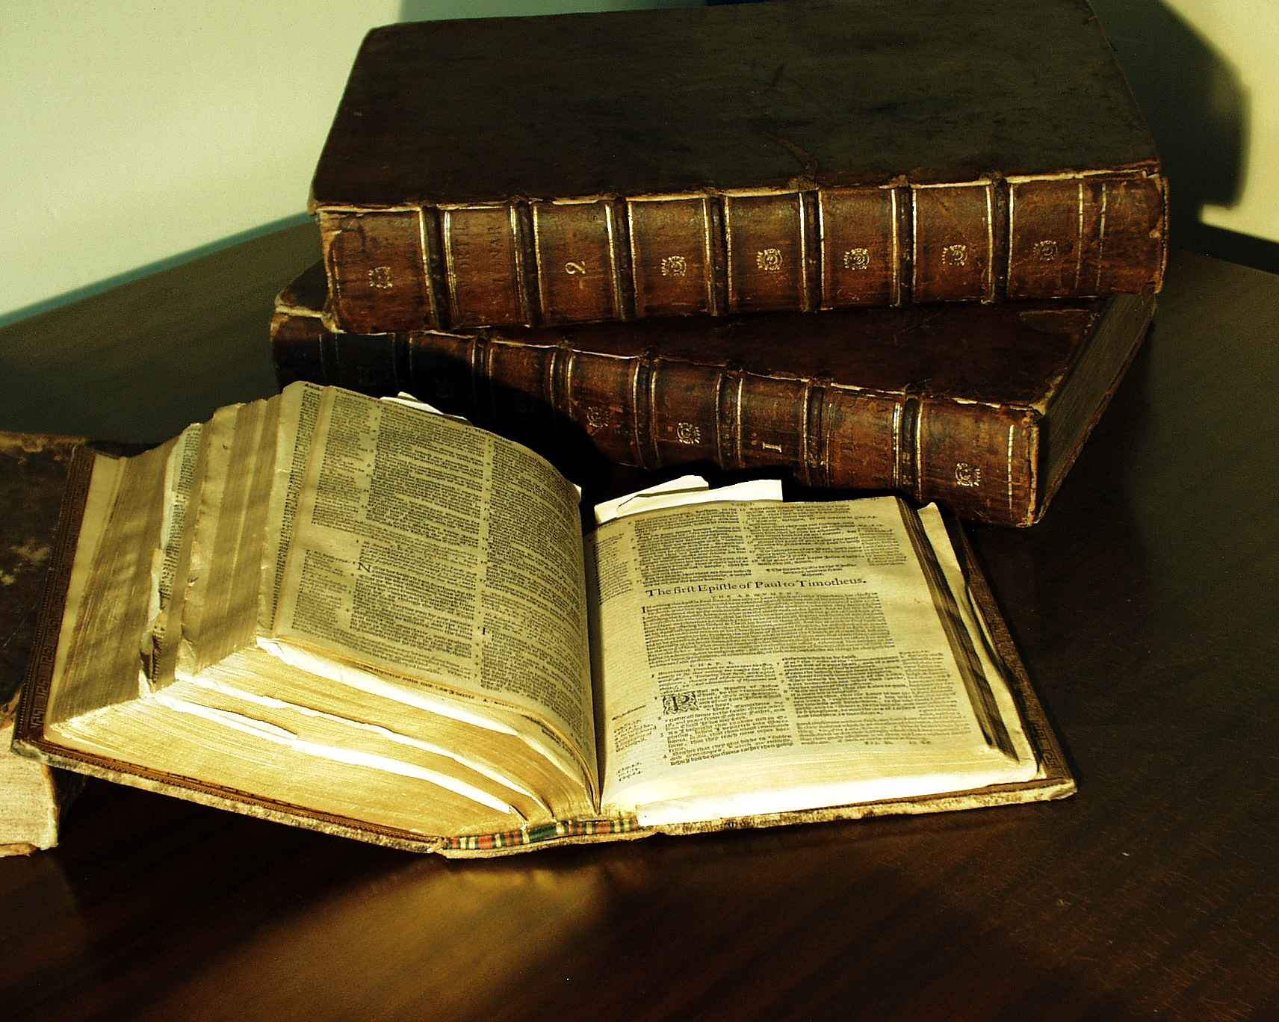
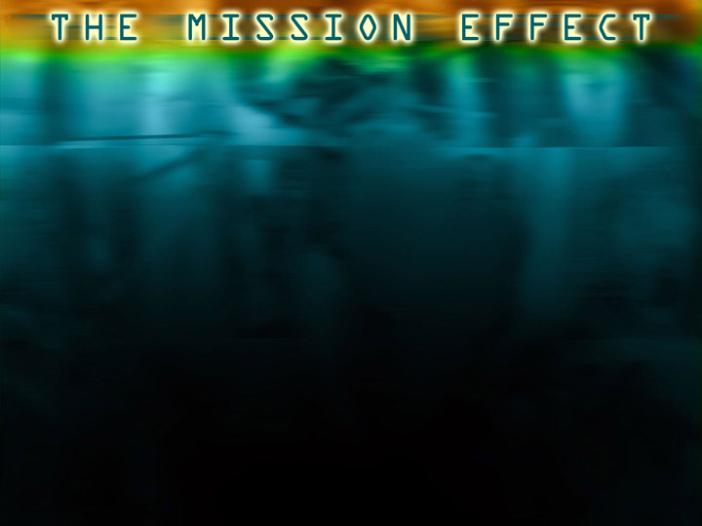
Everybody starts somewhere when they read the Bible.
  A textbook about God
  A handbook for happy living

Slide 4
The Mission Paradigm:
Reading the Bible as . . .
The revelation of the One True God
The story of human history and destiny
The story of God’s mission
The shaping of God’s people for mission
Mission Symposium 2012

Slide 5




A Missional Hermeneutic:
Read each passage. . .
In the light of the whole biblical story
In the light of the missional nature and purpose of the Bible
In the light of the missional identity of the interpreting community

Slide 6
Read each passage in the light of the whole biblical story
  Creation
  Fall
  Redemption
  The People of God’s Mission
  Consummation

Slide 7
Read each passage in light of the missional nature and purpose of the Bible
  What did this passage reveal about the One True God in that historic context?
  How did the behaviors, values, and teachings in this passage engage God’s mission in that historic context?

Slide 8
Read each passage in the light of the missional identity of the interpreting community
  What would the behaviors, values and teachings in this passage reveal about the One True God in my context?
  How would the behaviors, values, and teachings in this passage engage God’s mission in my context?

Slide 9
Read each passage in the light of the missional identity of the interpreting community
  What behaviors, values and messages would reveal the One True God in my context?
  What behaviors, values, and messages engage God’s mission in my context?

